Slide 1
Course Title - DevOps
Topic Title - Understanding DevOps movement, DevOps with changing time, The water fall model, Agile Model, Collaboration, Why DevOps, Benefits of DevOps, DevOps life cycle
Presenter’s Name - M ArunKumar
Presenter’s ID - IARE11151
Department Name - CSE (AI & ML)
Lecture Number - #
Presentation Date -

Slide 2
Course Overview
DevOps, a combination of "development" and "operations," is a software development methodology that emphasizes collaboration and communication between software developers and IT operations professionals.
The goal of DevOps is to streamline the software delivery process, from code development to deployment and maintenance, by breaking down silos between development and operations teams.

Slide 3
Course Objective
I. The DevOps Concepts for business cases, cloud provisioning and management services .
II. The model canvas for DevOps use cases.
III. The virtual machines and containers for designing of applications
IV. The code with various aspects in continuous deployment / development.

Slide 4
Course Outcomes
CO 1 Understands the DevOps concepts in continuous delivery / development of applications.
CO 2 Create the DevOps applications using various tools and technologies.
CO 3 Examine the virtual machines and containers for managing the files
CO 4 Apply cloud services for deployment the applications in a real-time
CO 5 Perform web security and testing the code with appropriate tools

Slide 5
Understanding DevOps movement
The DevOps movement is all about improving collaboration and communication between development (Dev) and operations (Ops) teams. Traditionally, developers would build software and pass it off to operations teams to deploy and maintain. This often led to bottlenecks, miscommunications, and inefficiencies. DevOps aims to break down those silos by fostering a culture of collaboration, with both teams working together throughout the entire software lifecycle—from development through to deployment and maintenance.
Notes:
a system, process, department, etc. that operates in isolation from others.

Slide 6
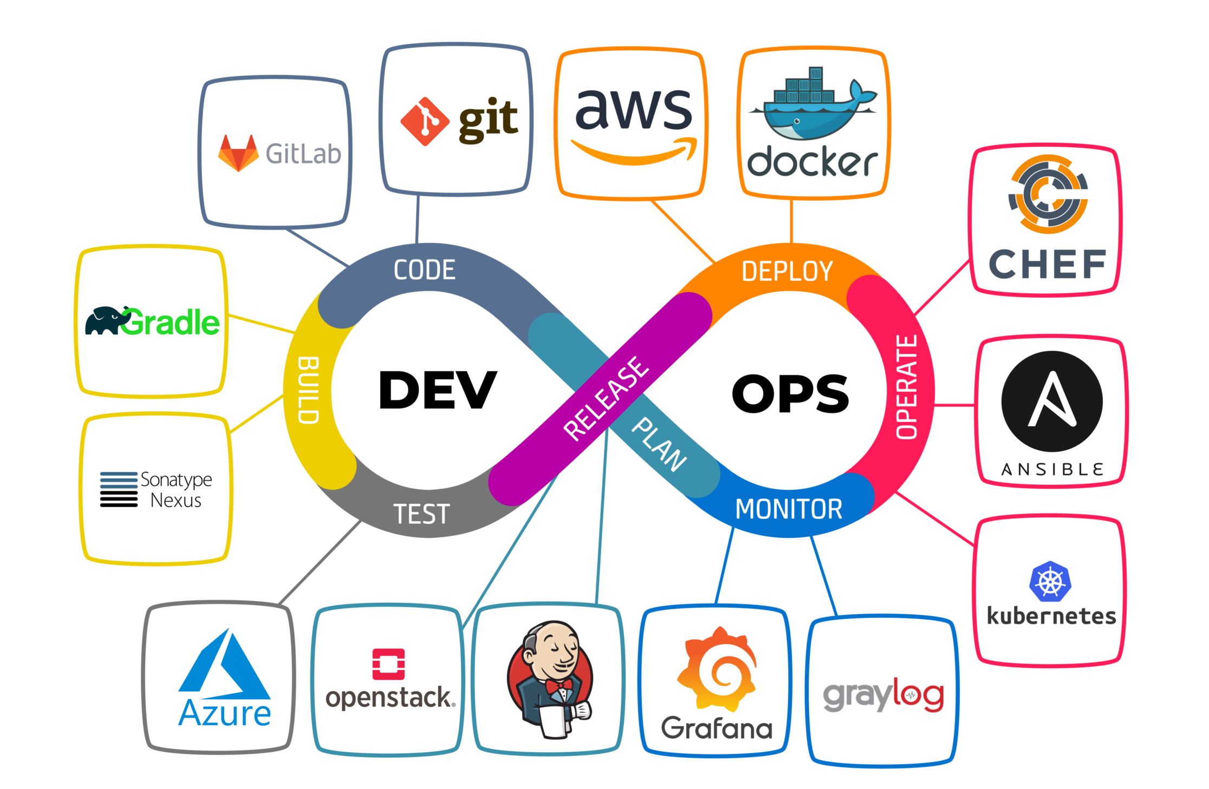

Slide 7
Understanding DevOps movement
Collaboration and Communication
Automation
Continuous Integration (CI) and Continuous Deployment (CD)
Monitoring and Feedback
Cultural Shift
Infrastructure as Code (IaC)

Slide 8
DevOps with changing time
Time Period | Key Developments | Focus Areas | Technologies/Practices
Early 2000s | Emergence of DevOps principles | Breaking down silos between Dev and Ops teams | Agile methodologies, manual deployment
2007-2010 | Growth of automation, CI/CD becomes a trend | Automating development and deployment | Jenkins, early CI tools, version control systems (Git)
2010-2013 | Rise of cloud computing and Infrastructure as Code (IaC) | Cloud infrastructure, scaling, automation | AWS, Azure, Terraform, CloudFormation
2014-2016 | Adoption of microservices architecture and containers | Microservices, containerization, orchestration | Docker, Kubernetes, Docker Swarm
2017-2019 | Introduction of DevSecOps (integrating security into DevOps) | Security automation, continuous testing | Static Analysis, Snyk, security automation tools
2019-Present | AI/ML-driven automation and advanced monitoring | Predictive insights, monitoring, observability | Prometheus, Grafana, AI for anomaly detection
2020-Present | Rise of Serverless architecture and serverless DevOps | Reduced infrastructure management | AWS Lambda, Azure Functions, Google Cloud Functions
2021-Present | Integration of Observability and Self-Healing Systems | Proactive issue resolution, deeper insights | OpenTelemetry, Jaeger, Elastic Stack, self-healing systems
Future (2025 & Beyond) | AI/ML in DevOps, advanced automation, and autonomous infrastructure | Intelligent automation, autonomous deployments | AI-driven CI/CD, advanced monitoring, predictive maintenance

Slide 9
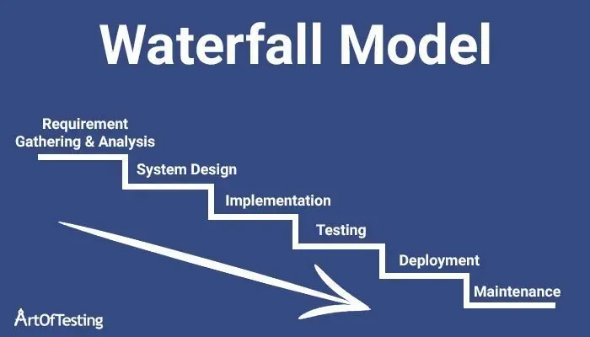
the waterfall model

Slide 10
Advantages | Disadvantages
Clear and Structured Process: | Inflexibility: Difficult to revisit or change earlier phases once completed.
Each phase has specific goals, making it easy to follow. | Changes in requirements later can disrupt the entire project.
Easy to Manage and Track: | Late Testing: Testing only happens after development, so issues may not be discovered until the end.
Progress is predictable with clearly defined milestones and deliverables. | Bugs and issues can be expensive and time-consuming to fix once discovered.
Detailed Documentation: | Assumes Stable Requirements: Assumes requirements are well-understood and fixed.
Provides comprehensive documentation at every stage, useful for audits and future reference. | If requirements change, the model becomes inefficient and costly.
Predictable Timelines and Costs: | Slow to Deliver: Final product is only available after all phases are completed.
Since scope, timeline, and costs are defined upfront, there’s less uncertainty. | The project may take longer to deliver, delaying feedback from the customer.
Well-Suited for Small and Simple Projects: | Risk of Misalignment with Customer Needs: Lack of customer feedback during development may lead to dissatisfaction.
Works well for projects with clear, fixed requirements and limited complexity. | The product may not meet evolving customer expectations or needs.
Minimal Customer Involvement: | Not Ideal for Complex or Large Projects: Struggles to manage evolving requirements in large, complex projects.
Once requirements are gathered, customer involvement is minimal. | The rigidity of Waterfall can be a drawback for large-scale, dynamic projects.

Slide 11
Agile Model
The Agile model is a software development methodology that emphasizes flexibility, collaboration, customer feedback, and the iterative delivery of functional software. It is a shift from traditional, rigid approaches like the Waterfall model, focusing on adaptability, quick adjustments, and delivering small, workable portions of the product frequently.
Customer collaboration over contract negotiation.
Responding to change over following a plan.
Working software over comprehensive documentation.
Individuals and interactions over processes and tools.

Slide 12
Why DevOps
The rise of DevOps comes from the need to address the gaps between development (Dev) and operations (Ops) teams in the software development lifecycle. DevOps aims to streamline and automate processes, improve collaboration, and increase the speed and quality of software delivery. Let’s break down why DevOps has become such an essential approach in today’s software development world
Key Reasons for Adopting DevOps
Faster Software Delivery, Improved Collaboration and Communication, Higher Quality and Reliability, Improved Efficiency and Automation and Better Customer Satisfaction

Slide 13
Benefits of DevOps
Benefit | Description
1. Faster Time to Market | Accelerates software development and deployment, enabling quicker release cycles and faster updates.
2. Improved Collaboration | Promotes collaboration between development and operations teams, breaking down silos and fostering teamwork.
3. Higher Quality Software | Continuous integration and automated testing lead to fewer bugs and higher-quality code delivered to users.
4. Increased Efficiency | Automation of manual tasks like testing, deployment, and monitoring improves team productivity and reduces errors.
5. Continuous Improvement | Encourages a culture of constant feedback and iteration, allowing teams to enhance processes and features.
6. Faster Issue Resolution | Automated monitoring and fast feedback help identify and resolve issues in real-time, reducing downtime.
7. Better Security | Incorporates security into every part of the development process, known as DevSecOps, minimizing vulnerabilities.
8. Scalability and Flexibility | Automates infrastructure management, allowing businesses to scale up or down easily in response to demand.
9. Cost Savings | Reduces operational costs by optimizing resources, automating repetitive tasks, and improving efficiency.
10. Improved Customer Satisfaction | Faster delivery of features and updates, along with a responsive development process, boosts user satisfaction.

Slide 14
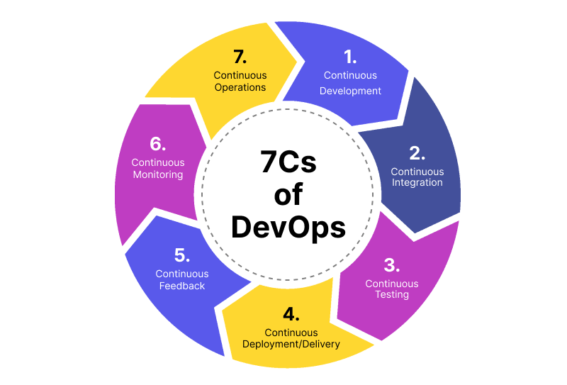
DevOps Life Cycle

Slide 15
DevOps Life Cycle
1. Continuous Development: This is the first stage, where development teams work on continuously integrating code and developing features. It involves writing, testing, and committing code to a version control system to prepare for deployment.
2. Continuous Integration (CI): In this phase, developers frequently merge their code changes into the central repository. Automated builds and tests are run to ensure the code is integrated smoothly, minimizing integration issues and bugs.
3. Continuous Testing: As the code is integrated, automated testing takes place at all stages. Continuous testing ensures the quality of the code is maintained, catches bugs early, and facilitates quicker feedback.
4. Continuous Monitoring: This phase involves the ongoing monitoring of the application and infrastructure in production. It allows teams to identify performance bottlenecks, system failures, and potential security threats in real time.

Slide 16
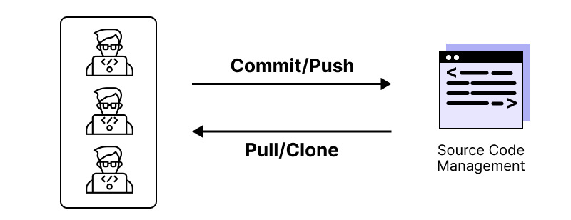
DevOps Life Cycle
1. Continuous Development: This is the first stage, where development teams work on continuously integrating code and developing features. It involves writing, testing, and committing code to a version control system to prepare for deployment.

Slide 17
DevOps Life Cycle
2. Continuous Integration (CI): In this phase, developers frequently merge their code changes into the central repository. Automated builds and tests are run to ensure the code is integrated smoothly, minimizing integration issues and bugs.
Detect changes in the source code repository (new commits appear)
Source code quality analysis
Build
Execute all unit tests
Execute all integration tests
Generate deployable artifacts
Report status

Slide 18
DevOps Life Cycle
3. Continuous Testing: As the code is integrated, automated testing takes place at all stages. Continuous testing ensures the quality of the code is maintained, catches bugs early, and facilitates quicker feedback.
Continuous testing involves the automation of testing activities to ensure that software changes are validated at each step of the pipeline, providing fast and reliable feedback to the development team, without the need for human intervention. The time saved thanks to continuous testing can be better spent on more strategic and planning tasks.

Slide 19
DevOps Life Cycle
5. Continuous Deployment (CD): After automated testing, the code is deployed to production automatically without manual intervention. This ensures faster delivery of updates and features to end users.
6. Continuous Feedback: Feedback loops from customers, stakeholders, and team members are incorporated at every stage of the lifecycle. This helps teams improve the product iteratively and adjust priorities based on real-time user and business needs.
7. Collaboration and Communication: Throughout the DevOps lifecycle, collaboration among development, operations, and other teams is critical. Transparent communication ensures that everyone involved understands objectives, potential issues, and requirements

Slide 20
DevOps Life Cycle
5. Continuous Deployment (CD): After automated testing, the code is deployed to production automatically without manual intervention. This ensures faster delivery of updates and features to end users.
6. Continuous Feedback: Feedback loops from customers, stakeholders, and team members are incorporated at every stage of the lifecycle. This helps teams improve the product iteratively and adjust priorities based on real-time user and business needs.
7. Collaboration and Communication: Throughout the DevOps lifecycle, collaboration among development, operations, and other teams is critical. Transparent communication ensures that everyone involved understands objectives, potential issues, and requirements

Slide 21
Thank You

